Slide 1
IT306M: Final End Sem Project: Training of Neural Network on Fashion MNIST Dataset Using OpenMP for Recognition
Mahule Roy (211MT026)
Mayank Sinha (211MT029)
Spoorthi Gumtapure (211CV248)

Slide 2
Introduction
Parallel computing divides a scientific computing problem into several small computing tasks, and concurrently runs these tasks on a parallel computer, using parallel processing methods to solve complex computing problems quickly.
Parallel computing is roughly classified as Multi- Core and Multiprocessor
One of the parameter to measure performance is execution time.

Slide 3
Objective
We use a Neural Network (NN) to classify the Fashion MNIST dataset using OpenMP
NN's parallel processing on GPUs and the ability to efficiently scale to a vast number of examples make it superior to traditional algorithms like support vector machines (SVM).
This adaptability, coupled with NN's prowess in capturing intricate complexities, positions it as an optimal choice for image classification tasks with large data.
Employing parallelization in our program becomes pivotal to enhance performance and conserve memory during the training of our Neural Network (NN)
Future applications of our study- Can be expanded for other important datasets and fields such as satellite imaging, remote sensing, material sciences, etc
Notes:
Applications, future work- other datasets

Slide 4
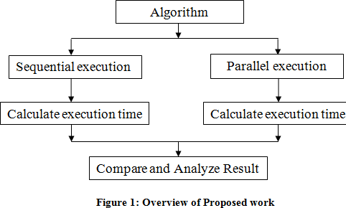
Objective
Notes:
Applications, future work- other datasets

Slide 5
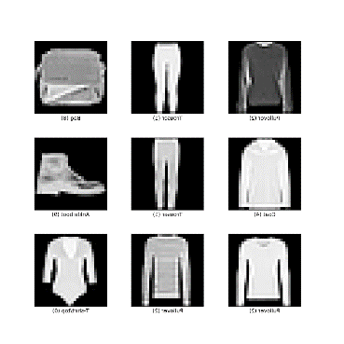
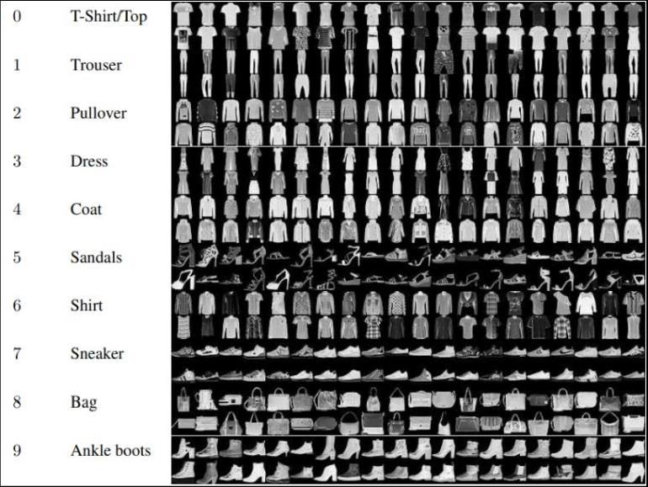
Dataset Used :- Fashion MNIST Dataset

Slide 6
Dataset Used
Fashion-MNIST is a direct drop-in alternative to the original MNIST dataset, for benchmarking machine learning algorithms.
MNIST is a collection of handwritten digits, and contains 70000 greyscale 28x28 images, associated with 10 labels, where 60000 are part of the training set and 10000 of the testing.
Fashion-MNIST has the exact same structure, but images are fashion products, not digits.
Dataset consists of two 785 columns CSV, one with training images, and the other with testing ones.
Each CSV row is an image that has a column with the label (enumerated from 0 to 9) and 784 remaining columns that describe the 28x28 pixel image with values from 0 to 255 representing pixel luminosity

Slide 7
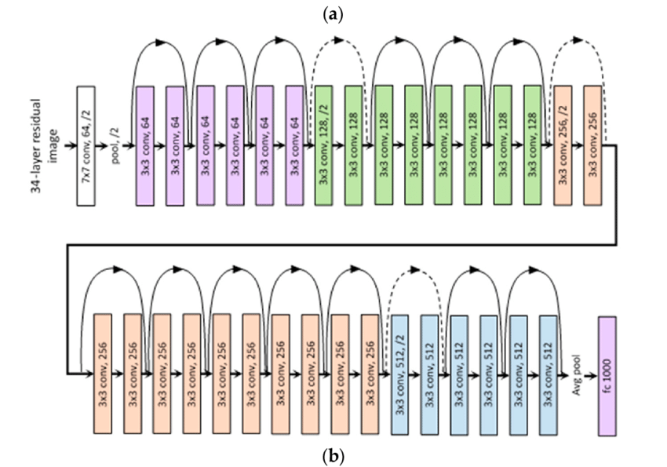
Implementation- parallelisation of ResNet Architechture using OpenMP
Notes:
OpenMP clauses- #pragma openmp for, #pragma openmp simd, atomic update
Resnet- CNN architectures were not able to scale to a large number of layers, which resulted in limited performance Vanishing/Exploding gradient. This causes the gradient to become 0 or too large. Thus when we increases number of layers, the training and test error rate also increases

Slide 8
Implementation
ResNet (Residual Network) - ResNet stacks multiple identity mappings (convolutional layers that do nothing at first), skips those layers, and reuses the activations of the previous layer. Skipping speeds up initial training by compressing the network into fewer layers.
ResNet neural network consisting of 2 layers with 150 and 10 neurons, respectively. The input vector holds 12 values. The weights are stored in WL1 [100] [12+1] (+1 is for the bias) and WL2 [10] [100+1] for layer 1 and 2, respectively. The internal states of the neurons are stored in DL1 [100] for layer 1 and DL2 [10] for layer 2, whereas their corresponding outputs in OL1 [100] and OL2 [10].
OpenMP clauses used- #pragma openmp for, #pragma openmp simd, atomic update
Data Processing is done by extracting the pixel value from the csv file and then bring down the values of RGB which is from 0-255 to 0-1 for our ease, by parsing the dataset.
We have parallelized the training part of ResNet, backpropogation, updating the weights etc to speed up our program.
No of threads used – 4 and checked the performance with 6 threads and 8 threads increased the run time by 10sec.
Notes:
OpenMP clauses- #pragma openmp for, #pragma openmp simd, atomic update
Resnet- CNN architectures were not able to scale to a large number of layers, which resulted in limited performance Vanishing/Exploding gradient. This causes the gradient to become 0 or too large. Thus when we increases number of layers, the training and test error rate also increases

Slide 9
Results and Conclusions
Total execution time-
Run the cpp file main.cpp for running the program
OpenMP: 1m 15s for 80% accuracy, 𝜶 = 0.2
Sequential/ non parallel: 3m 27s
Google Colab runtime for Fashion MNIST Dataset with TPU: 9s for 80% accuracy
Optimal performance observed when parameters were 𝜶 = 0.3 with accuracy of 84%
No. of neurons in first layer- 150, output layer- 10
Compilation time for parallel- 0.55sec
Notes:
Colab w tpu- 9s for 80% acc
OpenMP 1 min maxx for 82% acc alpha = 0.2
Seq- 3 min

Slide 10
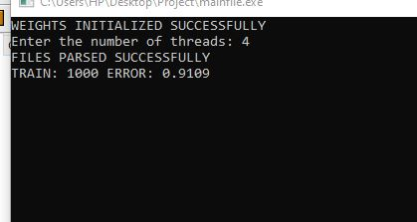
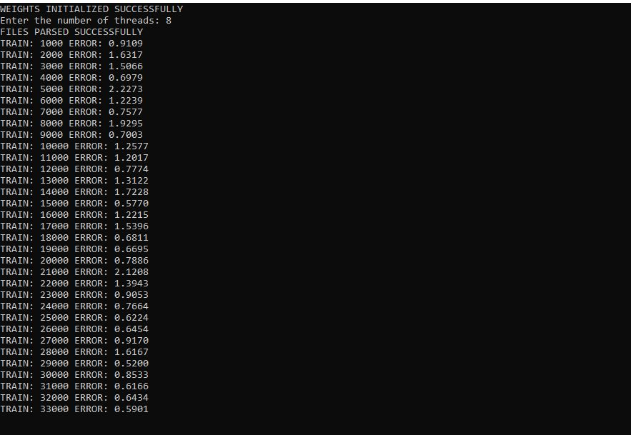
Screenshots
For threads used 4 runtime. Each epoch ran for 1 minute which is fast but lags behind Google Colab runtime of 55 sec.
For threads used 8 runtime was fast by 10 seconds.
The change was not that much since the program is already running in the best conditions possible as we are using simd for our parallel part of the program which makes the program execute multiple part of the data simultaneously.

Slide 11
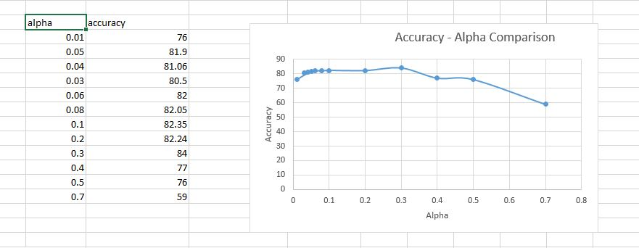
Visualization
Notes:
Colab w tpu- 9s for 80% acc
OpenMP 1 min maxx for 82% acc alpha = 0.2
Seq- 3 min

Slide 12
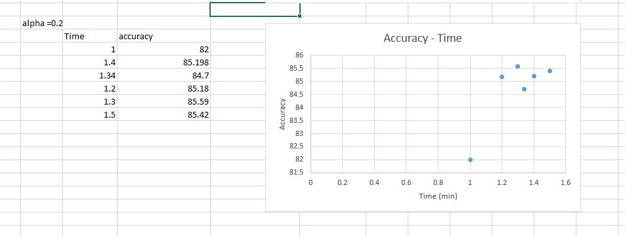
Visualization
Notes:
Colab w tpu- 9s for 80% acc
OpenMP 1 min maxx for 82% acc alpha = 0.2
Seq- 3 min

Slide 13
Demonstration
Below are the implementation of our project work, demonstration purpose recordings are added to the google drive links:
alpha = 0.2 value which gives accuracy of 82.24%
drive_link1
alpha = 0.6 value which gives accuracy of 63%
drive_link2

Slide 14
Future Work
Use a more complex architecture like AlexNet and increase the performance further as well as the speed.
Explore more clauses which can speed up the program and bring it closer to the runtime of the Google Colab implementation.
Extend this to other closely related dataset like MNIST which can be used for the aid of the blind people.

Slide 15
Thank you

